Slide 1
Welcome to
International School Almere
Diploma Programme

Slide 2
Simona Ghizdareanu
Diploma Programme Coordinator
DP Mentors:
Matthijs van Hilten
Suzanne de Maat
William van Leeuwenkamp
Freweyni Kidane
Koen van der Meijden
Maria da Silva

Slide 3
Why Diploma Programme?
Natural continuation of MYP
Universities recognize it and give credit for it
It is an international qualification
It offers academic breadth and depth
It creates independent learners
Students learn time management
Students are encouraged to develop critical thinking
And many other reasons…

Slide 4
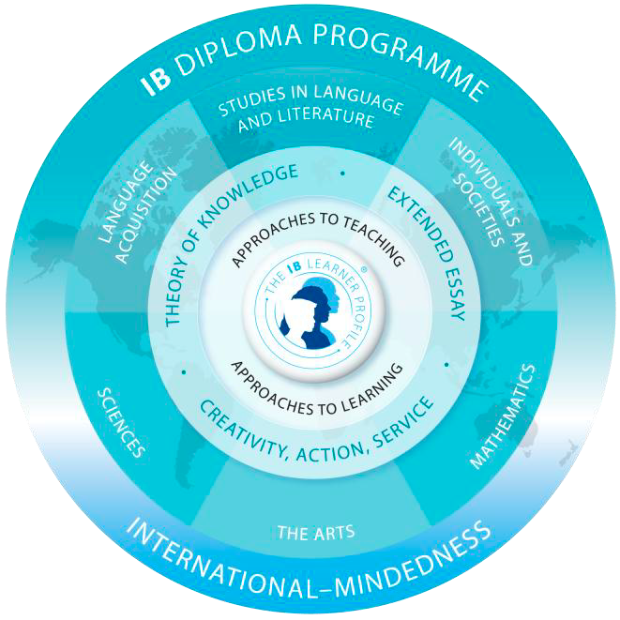
The Model

Slide 5
The six academic subjects
Three subjects taken at higher level (HL)
and
Three subjects taken at standard level (SL)
One subject of each subject group
and
One subject from each of the first five groups and one ‘free’ choice/group six subject

Slide 6
Group 1: Studies in Language and Literature (Language A)
Dutch A - Language and Literature course SL/HL
English A - Language and Literature course SL/HL
School supported self-taught language- Literature course- at SL only

Slide 7
Group 2: Language acquisition (Language B)
Dutch B SL/HL
French B SL/HL if sufficient number of students choose it
Dutch ab initio SL
Spanish HL/SL if sufficient number of students choose it

Slide 8
Group 3: Individuals and society
History SL/HL
Business and Management SL/HL
Economics SL/HL
Environmental systems and societies
SL only (interdisciplinary subject)
Global Politics

Slide 9
Group 4: Experimental Sciences
Physics SL/HL
Chemistry SL/HL
Biology SL/HL
Environmental systems and societies SL only (interdisciplinary subject)
Design technology

Slide 10
Group 5: Mathematics
Analysis and Approaches (AA) SL, HL
Applications and Interpretations (AI) SL, HL

Slide 11
Analysis and Approaches (AA) SL, HL
Analytic methods with an emphasis on calculus – appropriate for pure mathematicians, engineers, scientists, economists, those with an interest in analytic methods.
This subject is aimed at students who will go on to study subjects with substantial mathematics content such as mathematics itself, engineering, physical sciences or some economics
The graphic display calculator (GDC) is ONLY allowed in some of the written exams
Group 5: Mathematics

Slide 12
Group 5: Mathematics
Applications and Interpretations (AI) SL, HL
emphasis on statistics, modelling and use of technology – appropriate for those with an interest in the applications of mathematics and how technology can support this.
This subject is aimed at students who will go on to study subjects such as social sciences, natural sciences, medicine, statistics, business, some economics courses, psychology and design, computer science (because of the emphasis on technology)
The graphic display calculator (GDC) is required/allowed in all written exams

Slide 14
Group 6:The Arts
Visual Arts SL/HL
Music

Slide 15
The Core of the Programme
The extended essay
Theory of knowledge (TOK)
Creativity Activity and Service (CAS)

Slide 16
Theory of Knowledge (ToK)

Slide 17
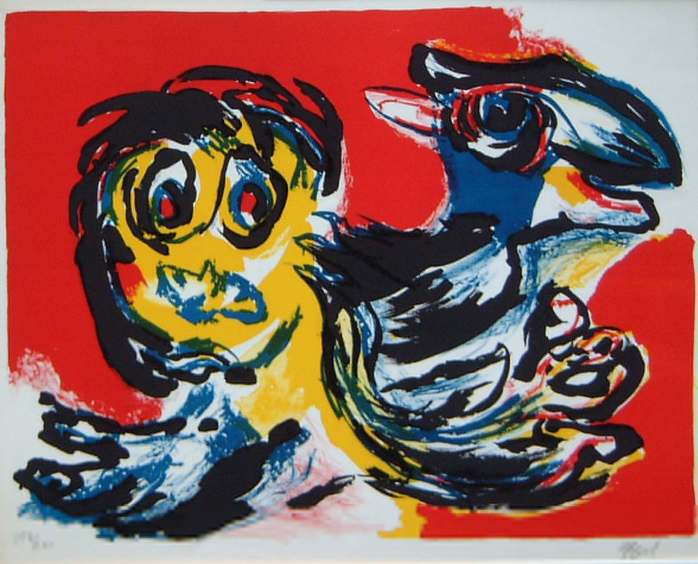
ToK
WHICH ONE IS ART?

Slide 18
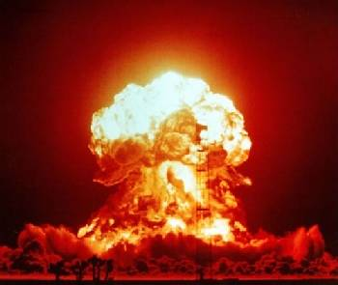
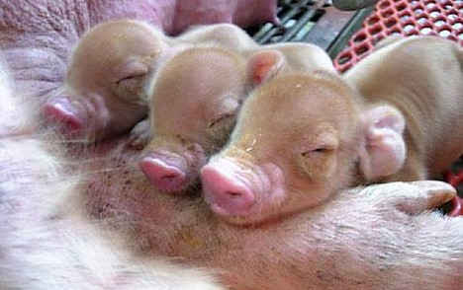
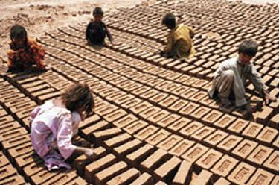
ToK
IS THIS RIGHT?

Slide 19
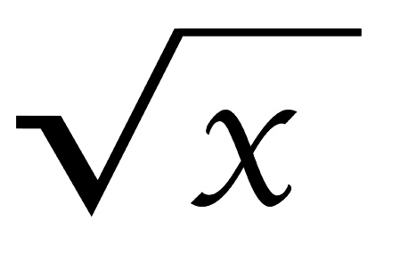
IS MATHS A LANGUAGE?
ToK
Uniquely human
Communicates
Uses symbols
The square root of two hundred and fifty divided by three plus seven
250
----- + 7
3
√250 -------- + 7 3
√250 -------- 3 + 7
50
√200 + ---- + 7
3
50
√200 + ----
3 + 7

Slide 20
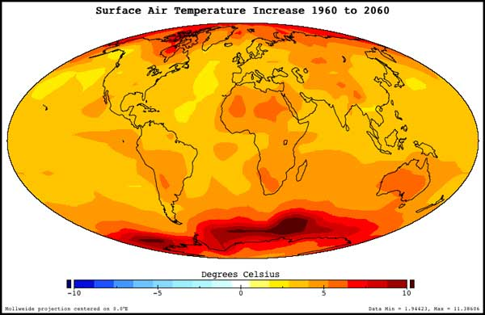
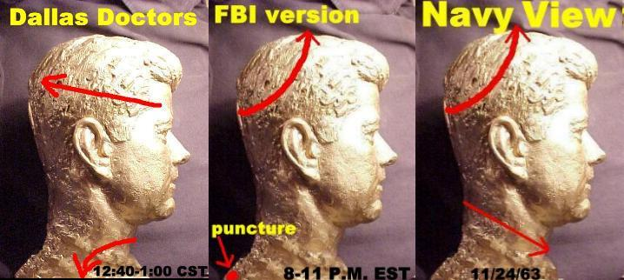
ToK
TRUTH?

Slide 21
Extended Essay
Similar to Personal Project (MYP5), at a more sophisticated academic level
Component of the IB diploma
Facilitating transition from school to university
Independent research with teacher as supervisor
Chosen from one of the 6 student’ subjects
No more than 4,000 words study topic of special interest

Slide 22
C(creativity)A(activity)S(service)
CAS is a natural continuation of Service and Action in MYP
CAS is organized around the three strands of creativity, activity and service defined as follows:
Creativity—exploring and extending ideas leading to an original or interpretive product or performance
Activity—physical effort contributing to a healthy lifestyle
Service—collaborative and reciprocal engagement with the community in response to an authentic need
(IB CAS Guide)

Slide 23
The successful completion of Diploma
Failing conditions :
1. CAS requirements have not been met.
2. Candidate’s total points are fewer than 24.
3. An N has been given for theory of knowledge, extended essay or for a contributing subject.
4. A grade E has been awarded for one or both of theory of knowledge and the extended essay.
5. There is a grade 1 awarded in a subject/level.
6. Grade 2 has been awarded three or more times (HL or SL).
7. Grade 3 or below has been awarded four or more times (HL or SL).
8. Candidate has gained fewer than 12 points on HL subjects .
9. Candidate has gained fewer than 9 points on SL subjects .
(IB Handbook of Procedures)

Slide 24
Guidance to university application
Individual talks with the Career Counselor
Use of Unifrog (platform for university counseling)
You will participate to Open Days organised by universities

